Slide 1
Backdoor Injection with Metasploit
Nathan Cooley, Shelby Pace, William Sanguinetti, Jeremy Thomas, Michael Towns

Slide 2
What is a Backdoor?
A backdoor is a method, often secret, of bypassing normal authentication or encryption in a computer system.
Backdoors are often used to secure access to a computer remotely.
Although often malicious, backdoors can be used by administrators to allow password restores, troubleshooting, etc.
Notes:
William

Slide 3
Setup
Install metasploit on host computer
Install Windows XP SP2 on a VM
Disable Windows Firewall on XP
Set VM to use bridged adapter
Disconnect from WPA2, connect to something else
Notes:
Michael

Slide 4
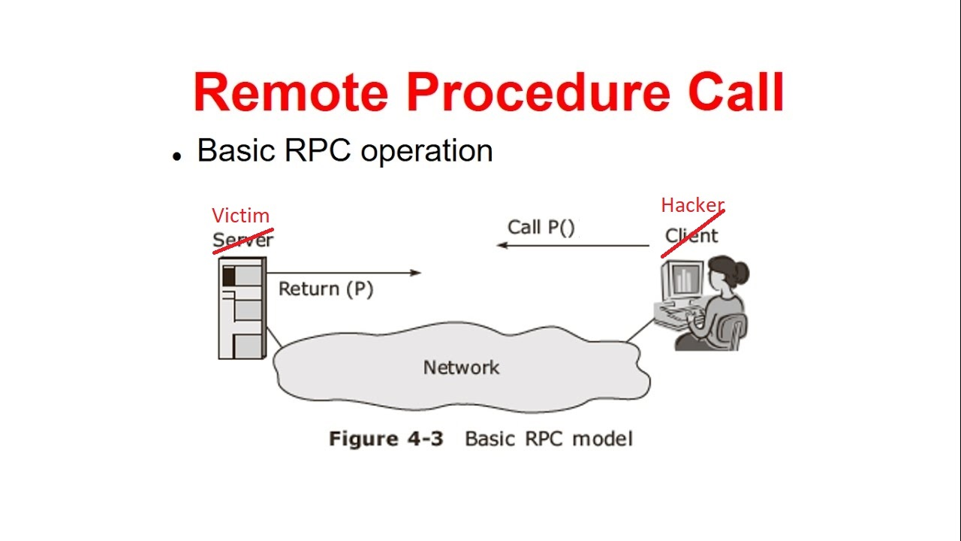
How does this Exploit Work?
A hacker can gain remote access to a computer by invoking a custom Remote Procedure Call (RPC) request
A RPC is when a program executes in a different address space(commonly on another computer on a shared network) as if it were executing locally.
Exploits parsing flaw in Windows RPC code.
Affects Windows 2000, XP, and Windows Server 2003
Notes:
Jeremy

Slide 5
Demonstration

Slide 6
Prevention
Block TCP ports 139 and 445
Firewall
Keep system up to date
Notes:
Shelby

